Slide 1
Online shopping System
Presented By: Supervised By:
Aqsa Rafique Dr. Ahmed Karim
BSIT-19-43

Slide 2
Content:
Abstract
Introduction
Challenges in online Shopping
Goals of project
Scope
Admin modules
User modules
Language used
Data flow diagram(DFD)
Use case diagram
Sequence diagram
Relational model from ERD diagram
User site & admin site screenshots
Conclusion

Slide 3
Abstract:
An online shopping system that encompasses various categories such as men's wear, women's wear, kids wear, electronic gadgets, home appliances, and furniture. The system aims to provide a comprehensive platform for customers to explore and purchase products from these diverse categories. Key features include user-friendly interfaces, advanced search capabilities, secure payment gateways, efficient order management, and reliable delivery services. Through an evaluation of customer satisfaction, product variety, and operational efficiency, this system showcases its potential to cater to the evolving demands of consumers and contribute to the growth of the online retail industry.

Slide 4
Introduction:
Our online shopping System aims to capitalize on this trend by offering a wide array of products to customers of all ages and preferences. From trendy clothes for women, men, and kids to stylish furniture, electronic gadgets, and essential home appliances, our platform provides a comprehensive shopping experience. The name of my shop is “Online Shop”. The name of my shop is “Online Shop”.

Slide 5
Challenges in Online Shopping:
Single Platform Multiple Shopping Categories
Management:
Order Cancellation Option for Customers.
Time Slot Management.
Manage Order Delivery via Calendar.
Streamline Online Shopping Process
Handle Customer Complaints.

Slide 6
Goals of Project:
Manage Online store in a comfortable way.
Facilitate Customers By offering a diverse range of products encompassing clothing for women, men, and kids, furniture, electronic gadgets, and home appliances.
With a user-friendly interface, secure transactions, and a vast selection of products, our platform is poised to cater to the evolving needs of modern shoppers, transforming the way people shop for essential items and indulge in the latest trends

Slide 7
Scope of Project:
This will help in the development and implementation of a robust and user-friendly platform that allows customers to browse, select, and purchase a variety of products online. Online shopping system allows users to create accounts, register their information, and securely authenticate themselves for a personalized shopping experience. This includes features such as profile management, order history, and wish lists. It includes features for adding new products, updating existing product information, managing inventory, and categorizing products effectively.
It ensures smooth order fulfillment and timely delivery of products and robust security measures to protect user information, including secure payment gateways, data encryption, and adherence to privacy regulations

Slide 8
Admin Modules:
Manage User
Users Lists
Product List
Add Product
Orders
Log Out

Slide 9
User Modules:
Main Page
User Register
User Log In
Product Categories
Add To Cart

Slide 10
Languages Used:
Frontend/ SOURCE LANGUAGE(S):
Front-End language
HTML5, CSS, JavaScript, Bootstrap 3
Back-End language
PHP
DBMS USED: MySQL
TOOLS/PACKAGES:
Xampp Control Panel Server, Sublime Text 3.

Slide 11
Data Flow Diagram (DFD):

Slide 12
Use-Case Diagram(admin site):

Slide 13
Use-Case Diagram(User Site):

Slide 14
Sequence Diagrams:

Slide 18
Relational Model From ERD:

Slide 19
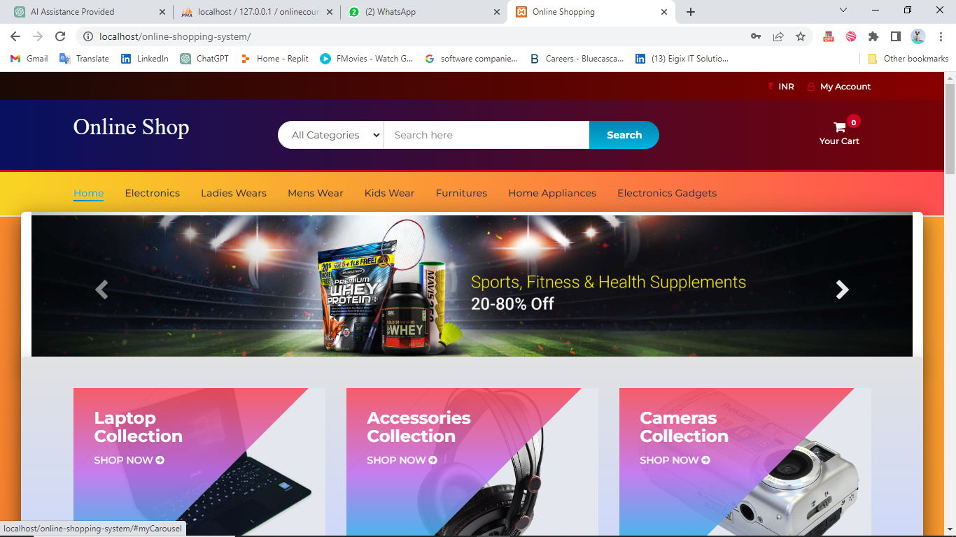
User Site & Admin Site Screen-Shots User Main Page:

Slide 20
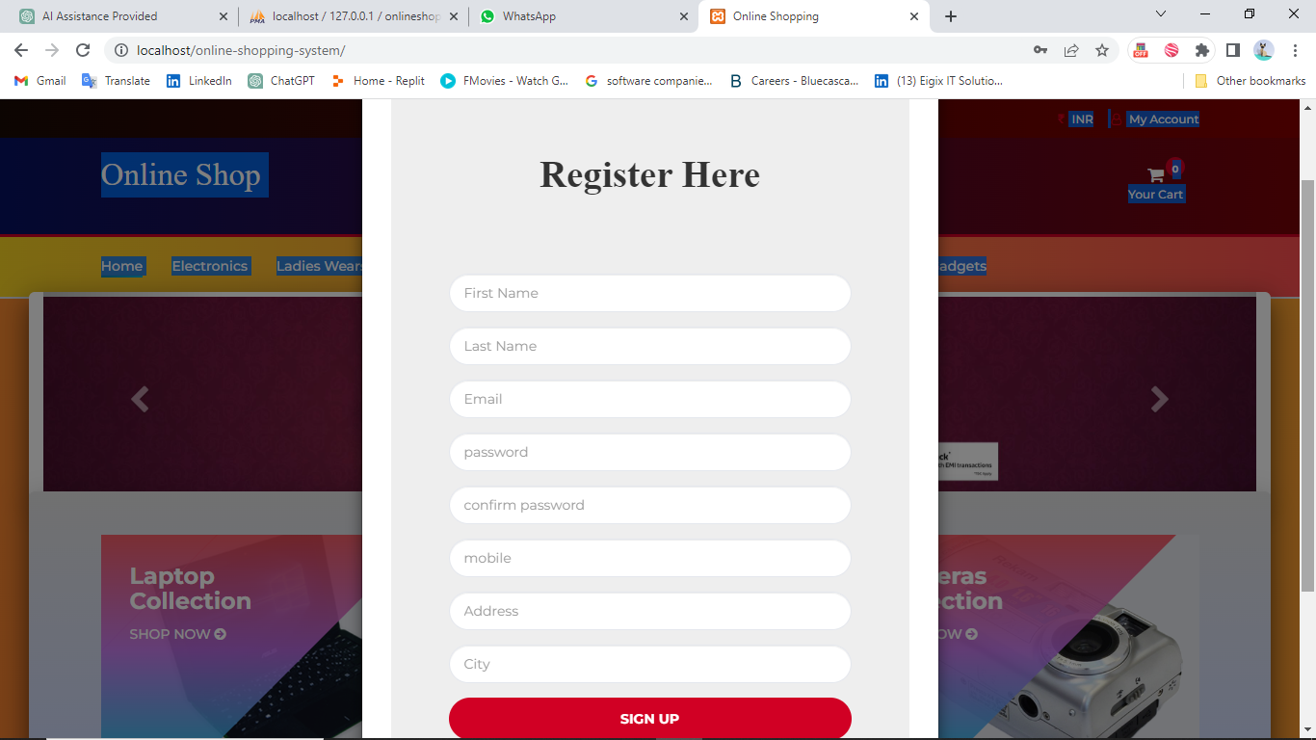
User Register:

Slide 21
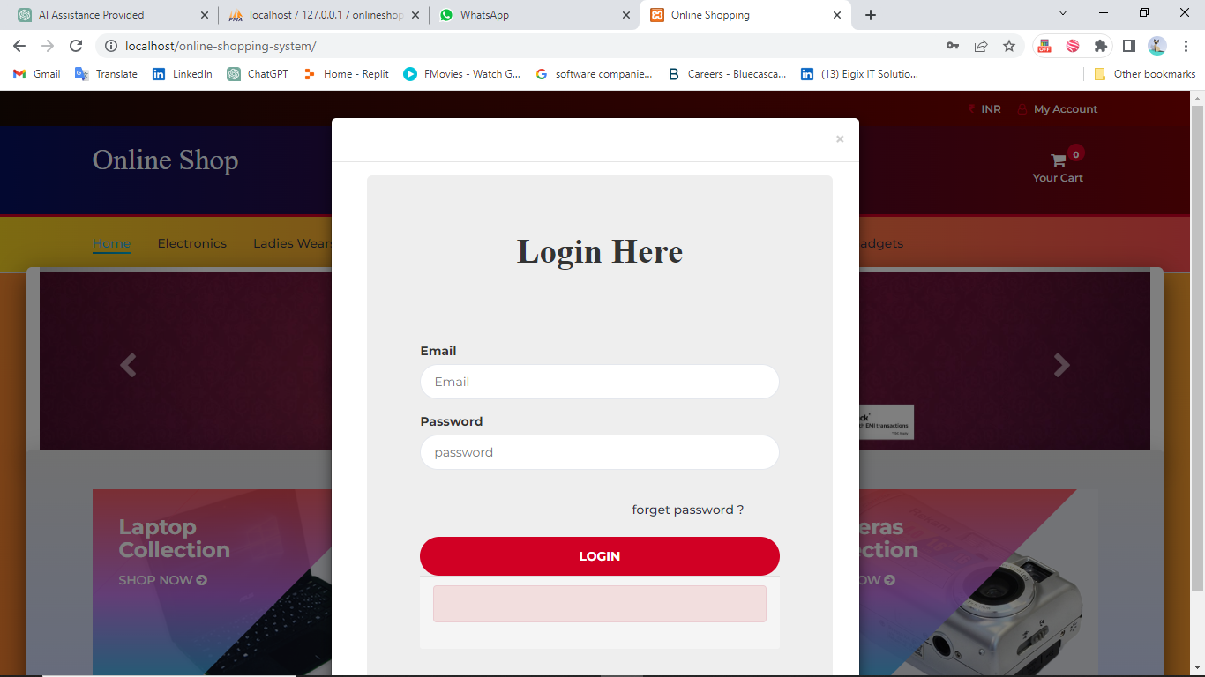
User Log In:

Slide 22
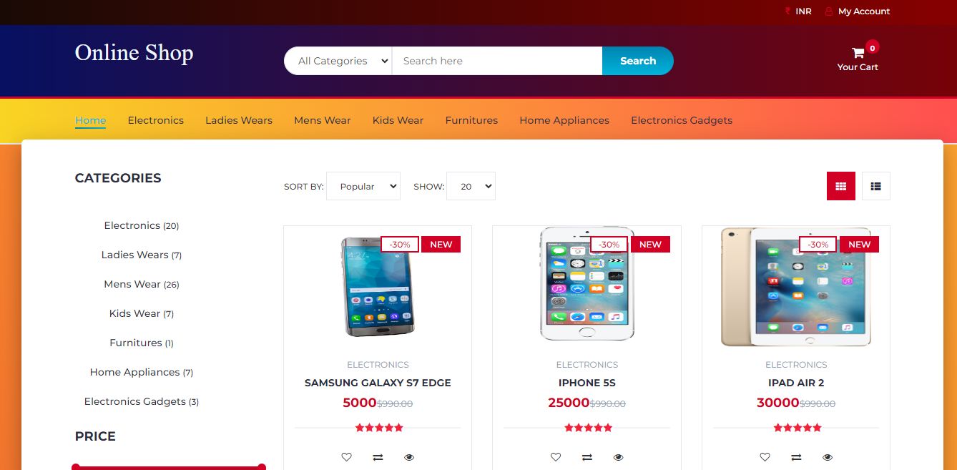
Product Categories:

Slide 23
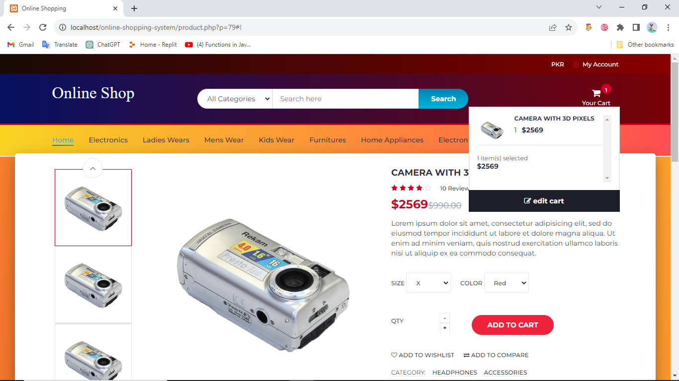
Add To Cart:

Slide 24
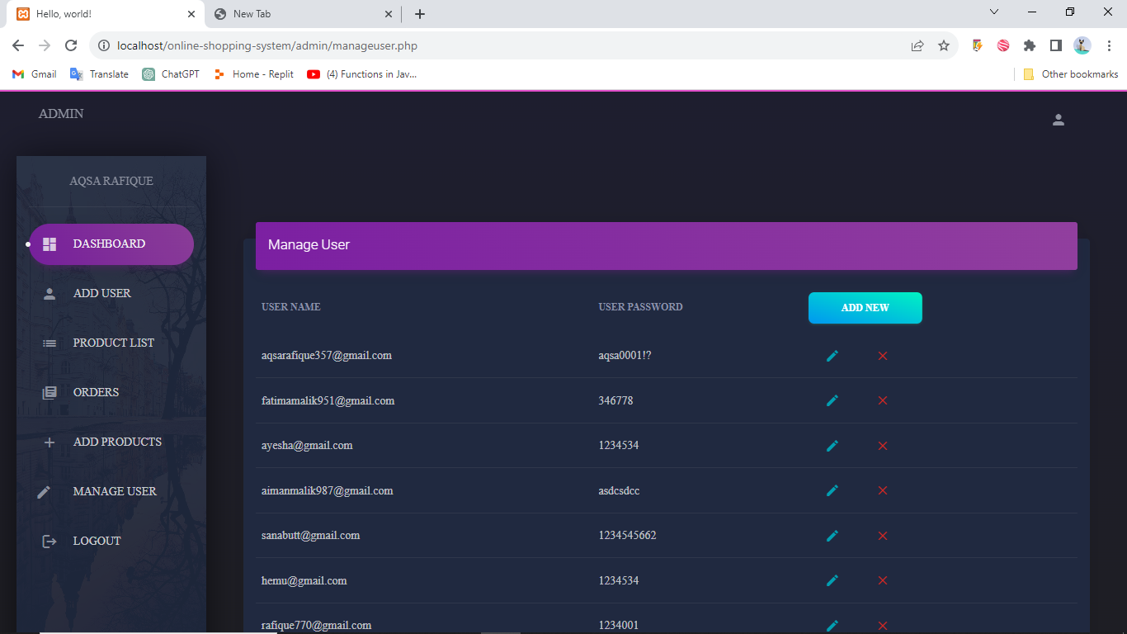
Admin site: (Manage Users)

Slide 25
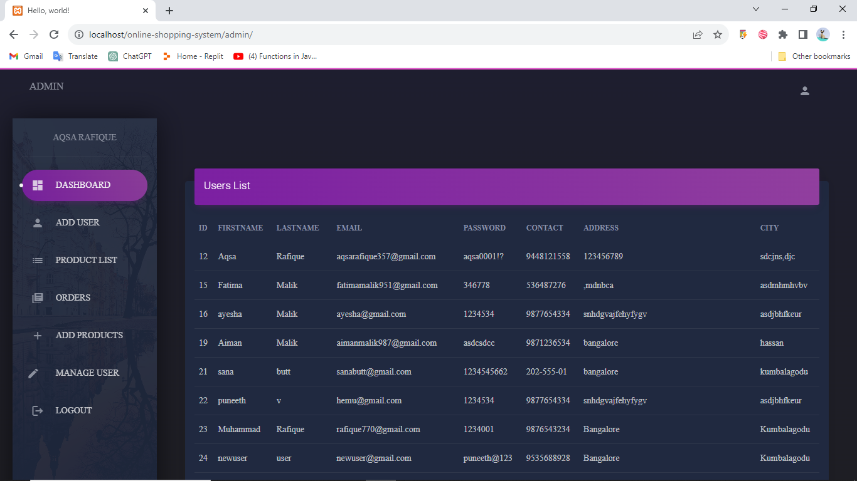
Users List:

Slide 26
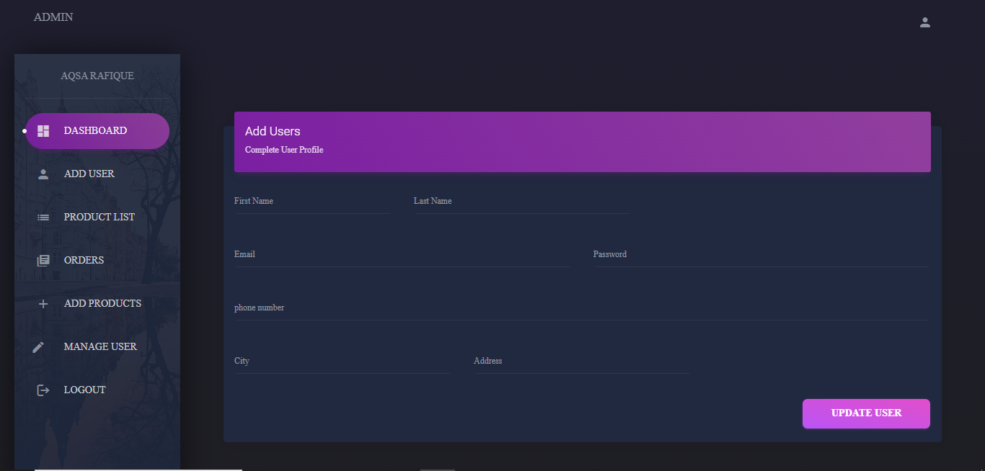
Add Users:

Slide 27
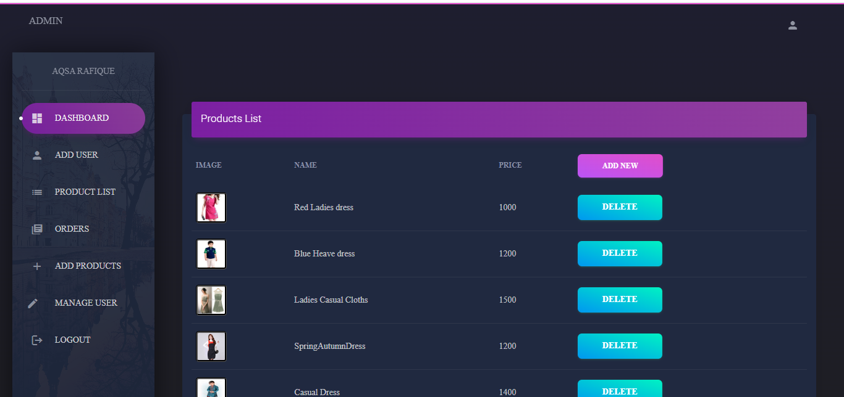
Product List:

Slide 28
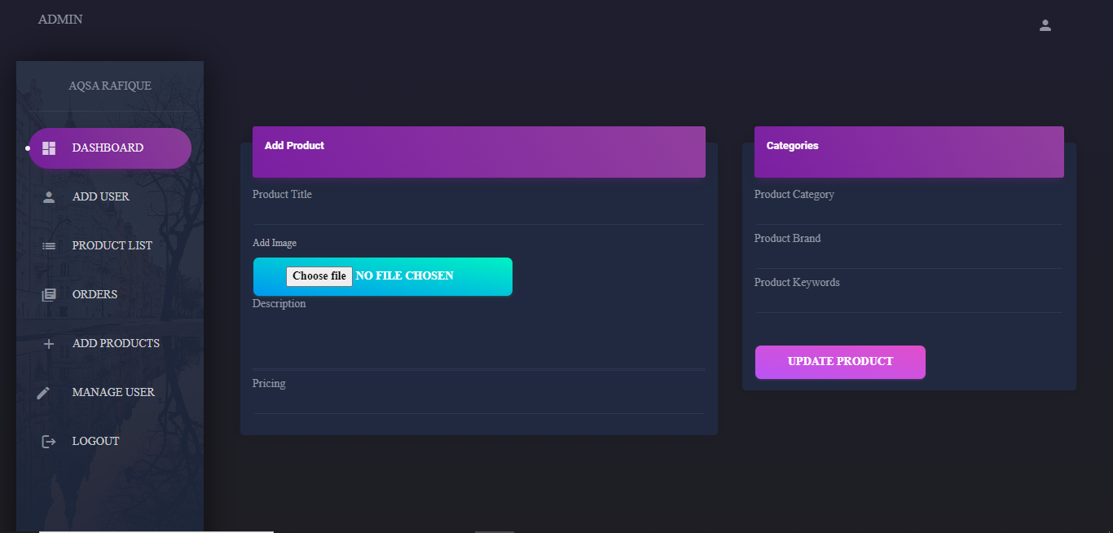
Add Product:

Slide 29
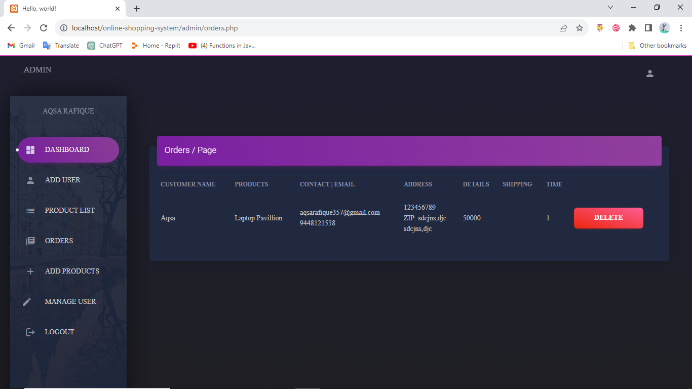
Orders:

Slide 30
Conclusion:
In conclusion, an efficiently designed online shopping system aims to enhance customer satisfaction, provide a diverse product range, streamline order management, and offer a secure and enjoyable shopping experience. With a well-structured setup and a dedicated team, the system can effectively meet the demands of customers and contribute to the success of the online business. The main aim of the online shopping system is to fulfill customer needs by offering a wide range of products, ensuring secure transactions, and delivering exceptional customer service. The work environment of such a system involves a combination of technological infrastructure, skilled professionals, collaboration, and a focus on continuous improvement.

